Slide 1


Customer Goods Ad-hoc Insights
AtliQ Hardware
SQL Project Challenge

Slide 2
About AtliQ Hardware
AtliQ Hardwares is one of the leading computer hardware producers in India and has successfully expanded its operations across multiple countries. The company is known for its innovative products and widespread presence in the global market.
However, despite its growth, AtliQ Hardwares struggles with a key issue:
“Lack of actionable insights to make quick and smart data-driven decisions”
AtliQ Hardware
SQL Project Challenge

Slide 3
Problem Statement
As the company scaled, leadership noticed they were missing key business insights needed for:
Strategic planning
Sales performance tracking
Cost optimization
Customer segmentation
To improve decision-making and data utilization, the management decided to expand their data analytics team by hiring junior data analysts.
AtliQ Hardware
SQL Project Challenge

Slide 4
Objective of the Challenge
To analyze operational and sales data using SQL queries and deliver key business insights for leadership decision-making.
The focus areas included:
Product Performance
Customer Behavior
SALES TRENDS
DISCOUNT IMPACT
MANUFACTURING COST

Slide 5
Atliq’s Product Lines
P & A
PC
PC
Peripheral
Accessories
Networking
Storage
Desktop
Notebook
WIFI Extender
External SSD
Gaming Laptop
Graphic Card
Business Laptop
PC
USB Flash Drives
Business Laptop
Internal HDD
PC
Personal Laptop
Personal Laptop
Motherboard
PC

Slide 6
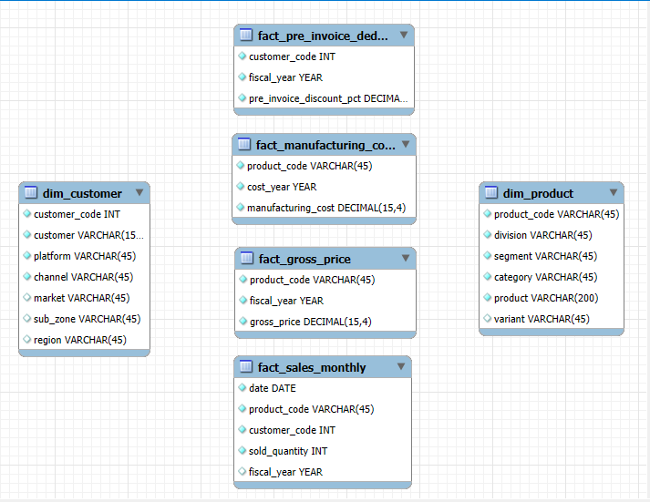
Dataset Overview
AtliQ Hardware
SQL Project Challenge

Slide 7
Ad-hoc request, queries and visualization
AtliQ Hardware
SQL Project Challenge

Slide 8
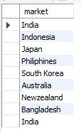
Request 1: Provide the list of markets in which customer "Atliq Exclusive" operates its business in the APAC region.
AtliQ Hardware
SQL Project Challenge

Slide 9
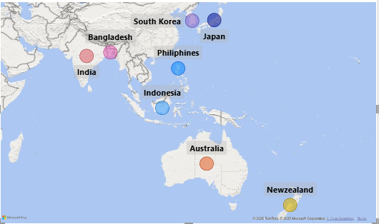
Insights
In the APAC region, our Exclusive store has established its presence in 8 major markets.

Slide 10

Request 2: What is the percentage of unique product increase in 2021 vs. 2020?
AtliQ Hardware
SQL Project Challenge

Slide 11
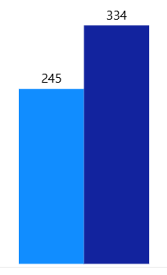
Insights
36.33 %
Increase
It’s a good sign that we are continuously innovating and introducing new products to the market. In FY 2020, we had a total of 245 products, but in FY 2021, our count increased by 36% to 334 products

Slide 12
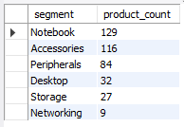
Request 3: Provide a report with all the unique product counts for each segment and sort them in descending order of product counts.
AtliQ Hardware
SQL Project Challenge

Slide 13
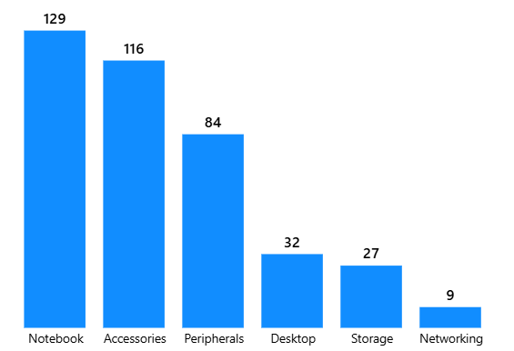
Insights
We provide a wide range of products under the segments Notebook, Peripherals, and Accessories, with an average of 110 products in each segment. However we still need to diversify our production in the Desktop, Networking, and Storage segments, where there are just an average of only 23 products per segment

Slide 14
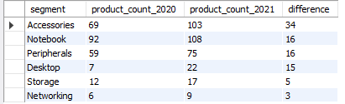
Request 4: Follow-up: Which segment had the most increase in unique products in 2021 vs 2020?
AtliQ Hardware
SQL Project Challenge

Slide 15
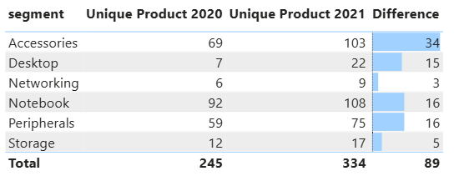
Insights
In 2021, we were mainly focusing on diversifying our accessories segment. We introduced 34 new products to the market in accessories.
Which segment had the most increase in unique products in 2021 vs 2020?

Slide 16

Request 5: Get the products that have the highest and lowest manufacturing costs.
AtliQ Hardware
SQL Project Challenge

Slide 17


Insights
Which of our products has the highest manufacturing cost?
Which of our products has the lowest manufacturing cost?
0.89$
240.53$
AQ Master wired x1 Ms (Standard 1)
Mouse
AQ HOME Allin1 Gen 2 (Plus 3)
Personal Desktop

Slide 18
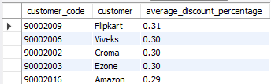
Request 6: Generate a report which contains the top 5 customers who received an average high pre_invoice_discount_pct for the fiscal year 2021 and in the Indian market.
AtliQ Hardware
SQL Project Challenge

Slide 19
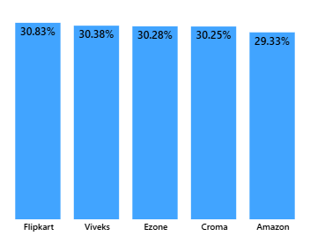
Insights
In 2021, we offered nearly equal pre-invoice discount percentages to each of our top 5 customers, given that Flipkart is the most discounted customer in the Indian market, which equals 30.83%.
Who are the top 5 customers for whom we offered the most pre-invoice discount percentage in 2021 and in the Indian market?

Slide 20
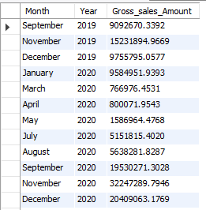
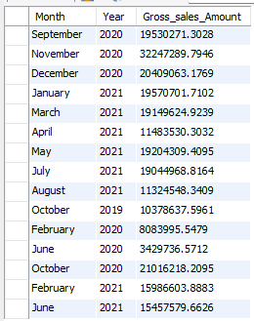
Request 7: Get the complete report of the Gross sales amount for the customer “Atliq Exclusive” for each month. This analysis helps to get an idea of low and high-performing months and take strategic decisions.
AtliQ Hardware
SQL Project Challenge

Slide 21
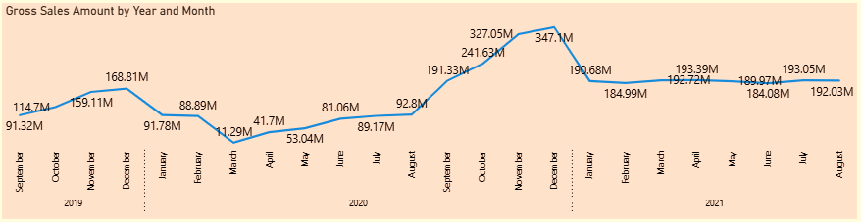
Insights
For AtliqExclusive, November 2020 marked the highest sales, and March 2020 marked the lowest gross sales. It’s very evident that the lower sales between March and August are because of COVID-19. However, it’s a very good sign that the sales increased quickly after August and reached the highest level since the last two years in November

Slide 22

Request 8: In which quarter of 2020, got the maximum total_sold_quantity?
AtliQ Hardware
SQL Project Challenge

Slide 23
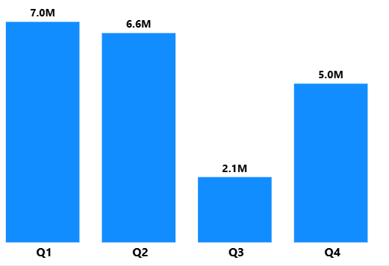
Insights
Quarter 1 has the maximum total sold quantity
This again complements the previous insight. That is the effect of COVID-19 on our sales. The sold quantity decreased to 2.1 million in quarter 3 of FY 2020, which was actually March, April, and May when COVID-19 was at its peak.
But we started recovering very early despite the continuance of the pandemic. This early recovery during quarter 4 is probably because of the increased need for hardware like desktops and notebooks as majority of the students began or continued to do their coursework online during this time, and there was a huge demand for computer accessories during this period

Slide 24

Request 9: Which channel helped to bring more gross sales in the fiscal year 2021 and the percentage of contribution?
AtliQ Hardware
SQL Project Challenge

Slide 25
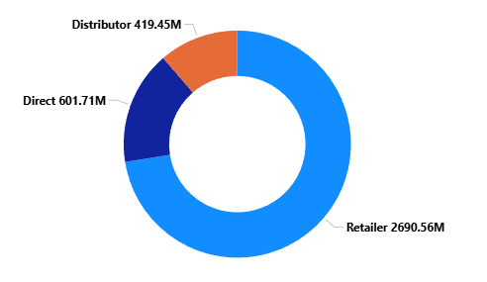
Insights
The majority of our sales took place via retailers, which is 75% of the total sales. Only a very small percentage of our sales happened through direct and distributor channels
In FY 2021, How are our sales distributed among the different channels through which we sell our products?

Slide 26
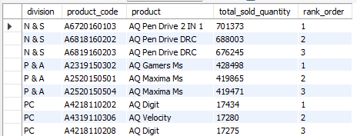
Request 10: Get the Top 3 products in each division that have a high total_sold_quantity in the fiscal_year 2021?
AtliQ Hardware
SQL Project Challenge

Slide 27
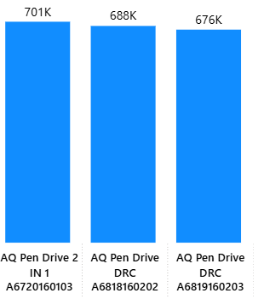
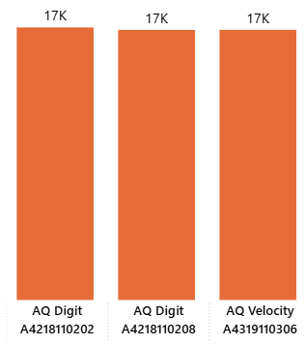
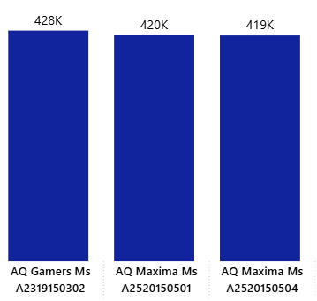
Insights
The top 3 selling products in N&S were pen drives, which were around 7 lakh in quantity
The top 3 selling products in P&A were mouse, which were around 4 lakh in quantity.
The top 3 selling products in PC were personal laptops, which were around 17000 in quantity
Which are the top 3 selling products in each of Atliq’s product lines in FY 2021?

